Slide 1
Baymax Hug
Gaurav, Namrita, Abhy, Charles, Emily, Christine

Slide 2
Purpose
Make an upper body endoskeleton that mimics hugging action
Place this frame inside an outer skin cover that resembles Baymax
Incorporate sensory input and watch Baymax hug you!!

Slide 3
Progress
Created an arduino-controlled hugging cardboard upper body
Attached 3 degrees of freedom on each arm: shoulder, elbow and wrist
Made arms hug at a press of a button

Slide 4
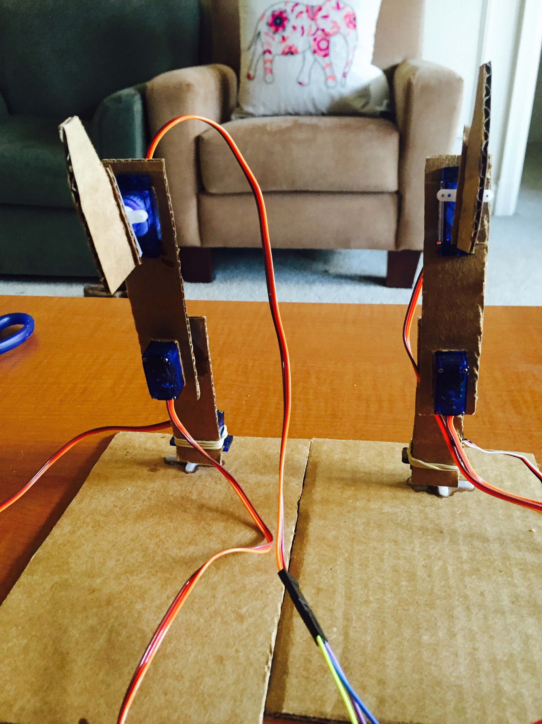
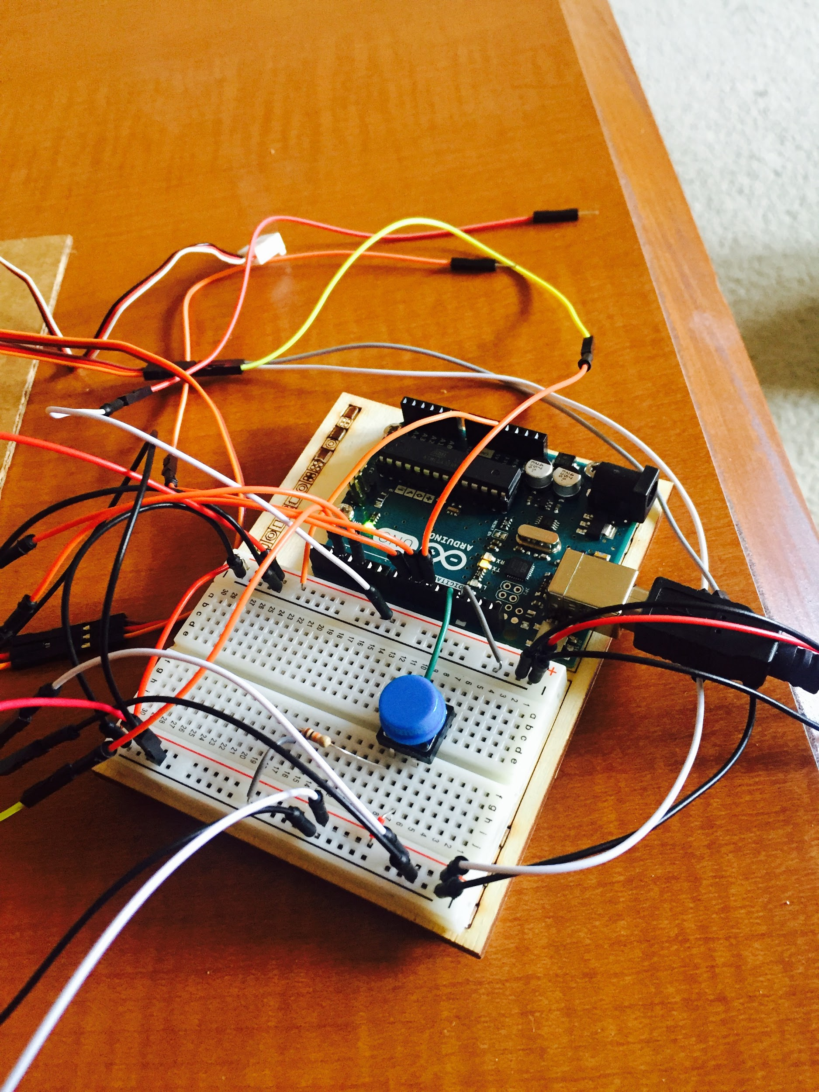

Slide 5
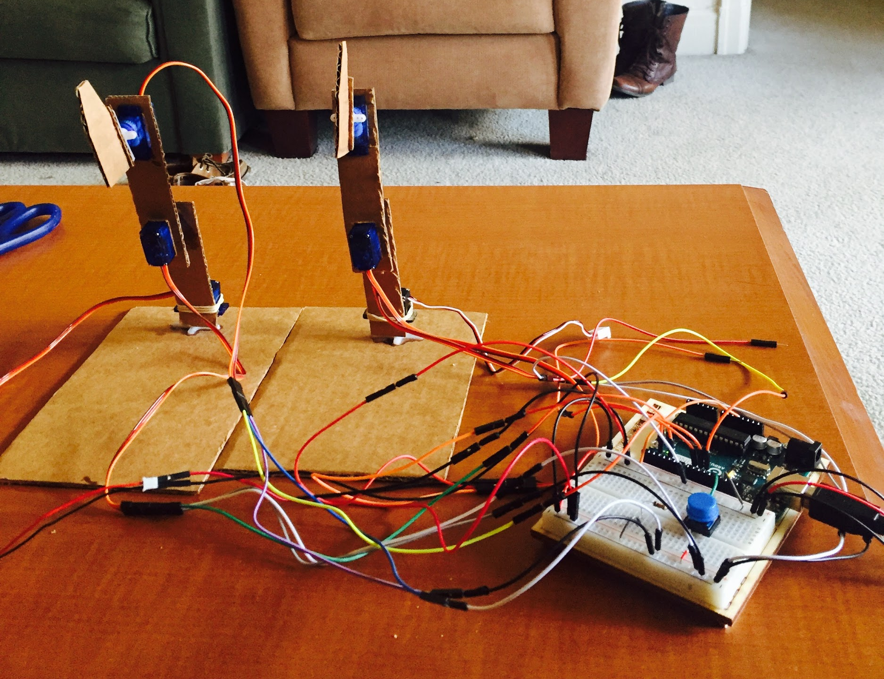
Wrist
Elbow
Shoulder

Slide 6
https://drive.google.com/file/d/0BzX2pMBIznCIbUJ6bWs5Sk40ZGM/view?usp=sharing

Slide 7
Next Steps
Add outer skin
Connect sensors to control hugging
Scale to a larger version
Add other interactions like waving / handshaking

